Slide 1
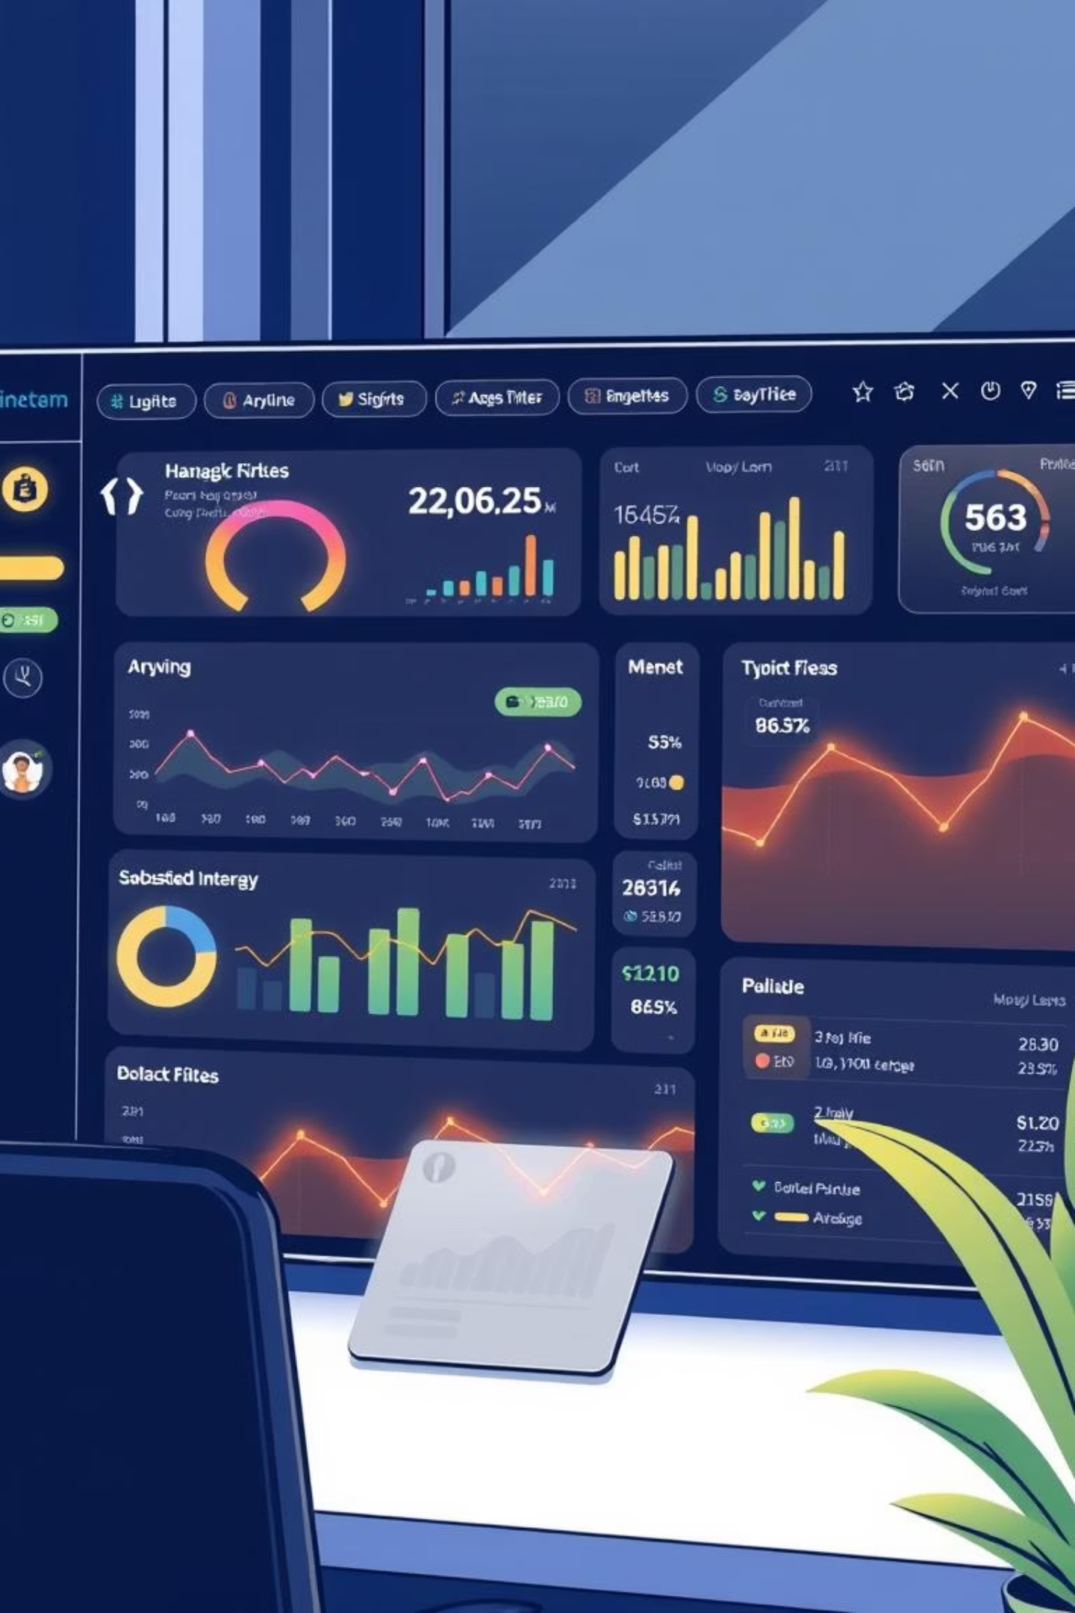
AI Microfinance Loan Management System
MLMS.AI
Empowering Financial Inclusion with Intelligent Automation

Slide 2
Title & Team Introduction
AI Microfinance Loan Management System
Tagline: Empowering Financial Inclusion with Intelligent Automation
Presented By: Team Innovators
Group Members:
Sidra Talib
Azra Talib
Ersa Rani

Slide 3

First Impressions: Modern Landing Interface
The Welcome Experience (User Onboarding)
Professional Design
Clear Branding
A professional, dark-themed opening screen with animated background elements for a modern look.
Clearly displays the App Name MLMS.AI and its purpose.
Team Identity
Features the "Innovators" branding with decorative icons at the bottom footer.
Interaction: A clean "Get Started" button that seamlessly transitions the user from the welcome screen to the secure main dashboard.

Slide 4

Why We Built This?
Project Overview & Problem Statement
The Challenge
Our Solution
Key Goal
Traditional microfinance is slow, paper-heavy, and risky due to manual verification.
A centralized web platform that automates loan lifecycles, from application to repayment.
To reduce default rates using AI and improve operational efficiency.

Slide 5
Technologies Powering MLMS.AI
Technology Stack
Frontend
Styling
AI Engine
React.js & TypeScript for robust and type-safe code.
Tailwind CSS for modern, responsive design.
Google Gemini API for intelligent risk analysis.
Analytics
Build Tool
Icons
Recharts for dynamic data visualization.
Vite for high-performance rendering.
Lucide React for intuitive visual elements.

Slide 6
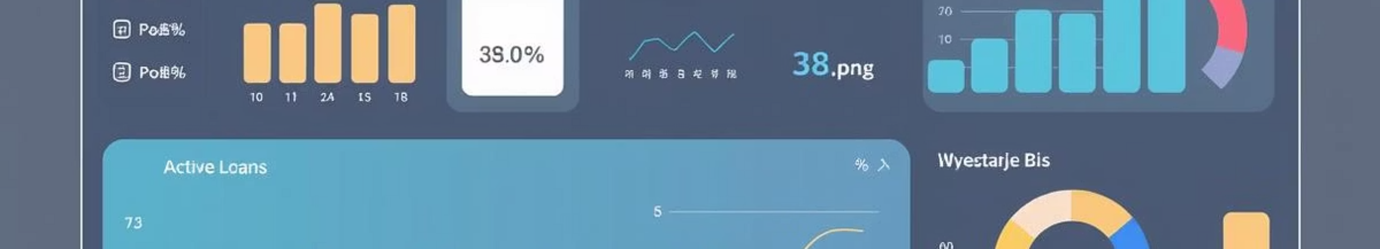
Operational Command Center
Dashboard & Real-Time Analytics
Key Metrics
Smart Alerts
Instant view of Total Active Loans, Portfolio Value ($), and Default Rates.
"Upcoming Repayments" widget notifies officers about payments due in the next 7 days.
Visual Data
AI Advisor
Bar charts showing loan status distribution (Active vs. Paid vs. Default).
Integrated button to fetch AI-driven operational suggestions.

Slide 7
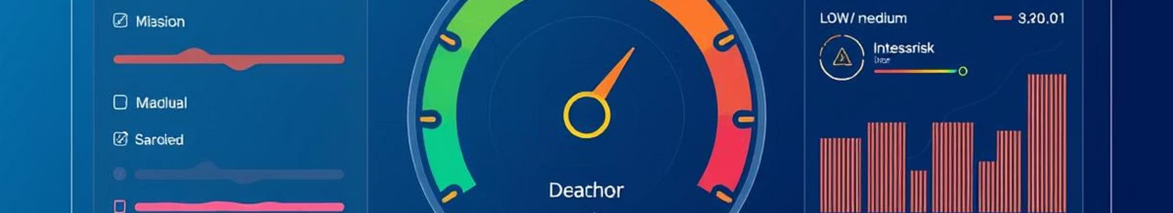
Intelligent Risk Profiling
AI-Powered Risk Assessment (Core Feature)
The risk engine calculates a dynamic risk score based on income, credit history, and KYC status.
Visual Gauge
AI Explanation
A speedometer-style gauge displays Risk Level (Low/Medium/High) in real-time.
Uses Google Gemini to explain why a client is risky in simple language (e.g., "High risk due to unstable income history").

Slide 8
360° Borrower Profiles
Client Management & Digital KYC
01
02
Digital Onboarding
KYC Verification
Captures personal details, employment info, and income data.
Upload and verify CNIC (Front/Back) and Selfie images.
03
04
Status Tracking
History Log
Toggle switch to mark clients as "Verified," which updates their risk profile.
Tracks every action taken on a client's profile for security.

Slide 9

End-to-End Loan Processing
Loan Lifecycle Management
Loan Products
Auto-Scheduling
Personal, Business, and Education loans
Repayment schedules with interest calculations
Approval Workflow
Status Tracking
Approve or Reject loans with a single click
Pending, Active, Paid, and Default states
Supports Monthly/Weekly repayment schedules with automatic interest calculations and visual badges for easy status identification.

Slide 10
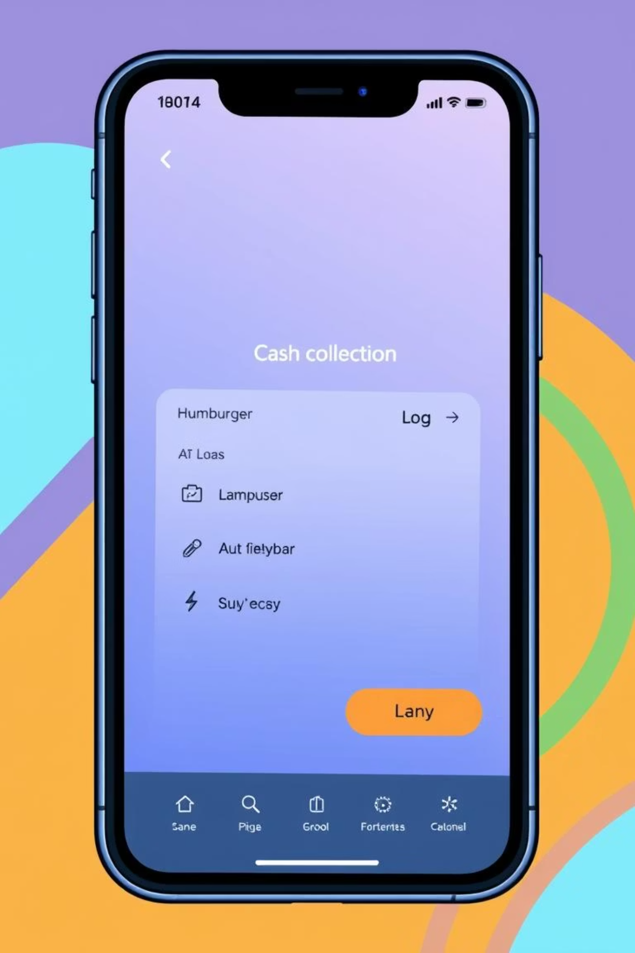
Designed for Field Agents
Mobile-First Field Operations
Responsive Design
Field Collections
The sidebar and layout adapt perfectly to mobile screens.
A dedicated view for agents to log cash collections and add remarks while visiting clients.
Mobile Menu
Custom "Hamburger" menu and top bar for easy navigation on phones.

Slide 11
Thank You from Team Innovators

